Slide 1

Hope and Mindset:
Transforming Ourselves, Our Colleges, and Our Students
Presented by
Sherrie Guerrero, Jim Fillpot, and Cindy Walker

Slide 2

SUCCESS
WHAT’S A RECENT SUCCESS YOU’VE HAD?

Slide 3

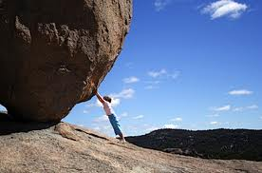
What obstacles did you have to overcome?

Slide 4
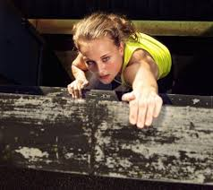
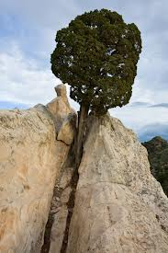
How did you overcome the obstacles?
Notes:
What did you learn from responding to/overcoming these obstacles?

Slide 5

How did you feel when you overcame the obstacles and reached your goal?

Slide 6

How can you apply this success to a new challenge you are facing?

Slide 7
Why Hope and Mindset?
Research regarding the influence of hope on behavior and thinking
“Actionable”
Translation of these strategies in the entire culture
Timeliness
Addressing cognitive factors wasn’t enough
Notes:
Sherrie
Increase in success, life satisfaction, etc.

Slide 8
Hope and Mindset at Chaffey
Notes:
Sherrie - Title V Grant, campus-wide, involves everyone, we can all impact directly or indirectly the culture of this campus and the success/hope levels of our students

Slide 9
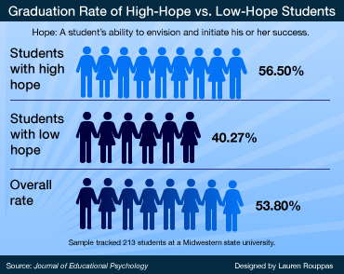
Does Hope Matter?
Notes:
Jim

Slide 10
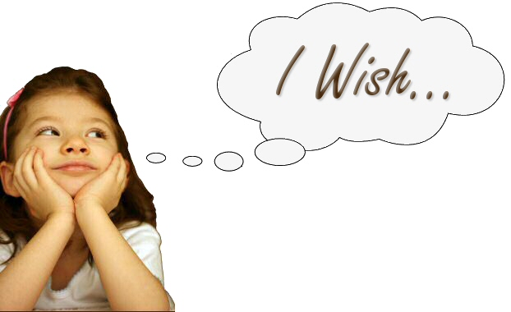
Hope is NOT…
Notes:
Cindy - Hope is not feeling mushy gushy about everything, it is not making things easier for people, it is not about solving other people’s problems, and it is not about dreams/wishes. Instead, you should keep standards high/challenging, but believe in people to attain those standards and give them the thinking/tools/strategies to achieve them; help guide people to solve their own problems; a wish is a dream without a plan, but hope requires a plan and a belief they can achieve that plan.

Slide 11
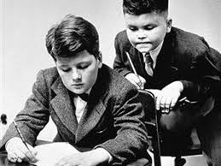
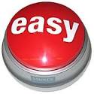
Hope is NOT…

Slide 12



Hope is…
Notes:
Specific, challenging, realistic, feasible, personal goals
Research reveals that people are less likely to achieve easy-to-reach goals. Why do you think that is the case? Procrastinate, less motivated, less of an achievement, bored, disengaged, don’t care, etc.
What happens if the goal is not your own? How can you make a goal your own?

Slide 13
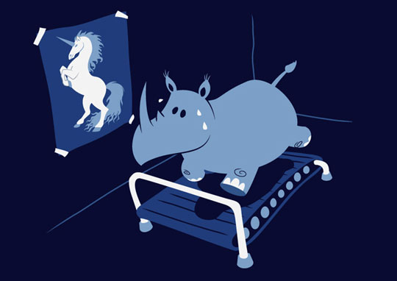
Set the right goals
Notes:
Specific
Challenging
Realistic
Feasible
Personal

Slide 14
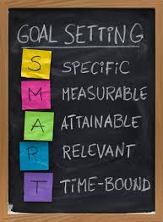
Set
SMART Goals

Slide 15
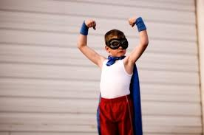

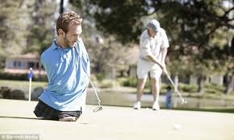
Hope is…
Agency

Slide 16


Hope is…
Waypower
Pathways
Notes:
Pathways/strategies, knowing how to get there or knowing where to get help, help-seeking behavior without overdependence, not letting obstacles stop you
Many of our students are first-generation college students – they often don’t know how to navigate college structures, processes, or understand the expectations; don’t assume, engage them in pathways thinking
How can you engage others in pathways thinking? Example: student says they want to drop their class because they can’t do their homework b/c they don’t have a computer. Possible questions: What other resources/options exist on or off campus where you can get access to a computer? How could you arrange your schedule to use those computers? What motivated you to come to college/what is your goal? Are you going to let the simple fact that you don’t have a computer stop you from achieving your goals?

Slide 17
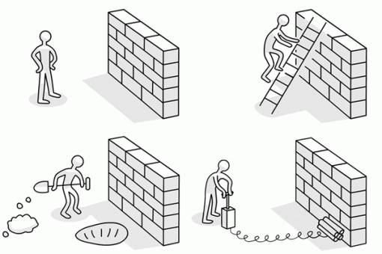
Overcoming Obstacles

Slide 18
Hope Defined
Hope
Agency
Pathways
Goals
  From “Managing for High Hope” by C.R. Snyder, Ph.D. - #162 from R&D Innovator Volume 4, Number 6 June 1995
Notes:
Page 122 of Hope Theory, Measurements, and Applications to School Psychology: “hope theory reflects individuals’ perceptions regarding their capacities to (1) clearly conceptualize goals, (2) develop the specific strategies to reach those goals (pathways thinking), and (3) initiate and sustain the motivation for using those strategies (agency thinking). “ Pathways and agency thinking are both necessary, but neither is sufficient by itself to sustain successful goal pursuit.

Slide 19
Hope and Mindset Continuum
Stand in the part of the room that represents the hope and mindset of the example statement (make a grid of the room)
Notes:
Cindy - 2. Sam, an honors student approaches you after class looking very upset. He explains to you that he has always gotten ‘A’s in his classes, but he is getting a C in your class. He has never gotten a C before and doesn’t think his lower grade is his fault. He tells you that your tests aren’t fair and that he thinks he deserves a better grade because he has done all the homework and attended class regularly
Ted, a faculty member states, "I don’t understand why we have to change all of the time. If the students were better prepared, I could actually do my job. My department cannot keep up with the workload unless we get new faculty.
Yvonne, a manager at your college, states, "I only have time to keep up with the reports and daily emergencies. I don’t know when I am going to have time to work on planning for the future. Because of the budget, there is very little I can do to address the needs of my department.

Slide 20
Data Collection Process
Over 12,000 individuals assessed annually
Approx. 95% - 98% of new students participate in assessment
Data captured at the point of assessment:
  Student Demographic Data
  Standardized Assessment Test Data
  Educational Background Characteristics
  Other Data Elements
  Non-Cognitive Measures
Notes:
Jim –
Examples of Educational Background Characteristics –
Years of High School Education
Years Out of High School
High School GPA
Years of High School English Completed
Last Grade Earned in English
Years of High School Mathematics Completed
Last Grade Earned in Mathematics
Highest Level Math Course Completed
Are You the First Person in Your Immediate Family to Attend College?
Examples of Other Data Elements
Employment Hours Planned
How Important is College to You Personally?
How Important is College to the People Closest to You?
Parents’ Highest Level of Education
Self-Rated Reading Skills
Self-Rated Writing Skills
Self-Rated Writing Experience
Number of Hours You Intend to Study per Week
Number of Hours Intend to Set Aside for Non-School Responsibilities
Applied or Intend to Apply for Financial Aid
Number of Hours a Week Spent Reading Novels, Newspapers, Magazines, Articles, etc.
How Many Books Have You Read for Fun in the Past Six Months?

Slide 21
Non-Cognitive Data Currently Collected
Hope
Mindset
Self-Efficacy
Metacognitive Self-Regulation
Time and Study Environment
Communication
Critical Thinking
Global Awareness
Notes:
March 2009 - Self-Efficacy added to assessment process – Motivated Strategies for Learning Questionnaire (MSLQ)
July 2011 – Hope scale added to assessment process – Adult Trait Hope Scale
March 2013 – Mindset, Organization, Self-Regulation, Time and Study Environment, Help-Seeking behavior added to assessment process – mostly at the request of English faculty – Dweck (Mindset); Other scales - Motivated Strategies for Learning Questionnaire (MSLQ)
March 2015 – dropped Organization and Help-Seeking Behavior; added core competencies:
Communication
Critical Thinking
Global Awareness
Personal/Academic/Career Development

Slide 22
Specific to Hope…
Five first-time, no prior college experience cohorts examined:
  2011 (N = 827 students)
  2012 (N = 3,261 students)
  2013 (N = 3,241 students)
  2014 (N = 2,808 students)
  2015 (N = 4,461 students)
Five-year total – 14,598 students

Slide 23
Hope Scale Score Distribution
Low
Hope
Average
Hope
High
Hope
Number of Students Assessed
Hope Scale Total Score
N = 4,461; mean = 52.75; median = 54.0; standard deviation = 6.78
Notes:
Adult Trait Hope Scale – eight items on eight point scale, range is 8 - 64
4 = Agency
4 = Pathway
Conversation with Gallup Organization – what is high, average, low hope? What scores correspond? Gallup response – relative to the population being assessed; factory worker in China, farmer in Canada, shopkeeper in Germany will all have different levels of hope relative to their experiences and environment (Future Readiness scale also takes into account engagement and wellbeing). Student at Chaffey College in Southern California cannot be compared to other populations, suggested examining high/average/low hope by standard deviation – one below = low hope; one above = high hope.

Slide 24
Observed Hope Group Differences by
Student Demographic Characteristics
Examined Hope Group Membership by:
  Gender
  Race/Ethnicity
  Age Range
  Disability Status
  Economically Disadvantaged Status

Slide 25
Observed Hope Group Differences by
Student Demographic Characteristics
No meaningful effect size differences but:
  More likely to be high hope
    Multi-Racial/Ethnic students
    African American students
    Caucasian students
  More likely to be low hope
    Asian students
    Students with Disabilities
    Older (40+ Years of Age)

Slide 26
Tracking of Performance Outcomes
First Semester Success and Retention Rates
Persistence Rate (multiple semesters)
Basic Skills Attainment (English & Math)
Unit Attainment (multiple unit thresholds)
Completion of Transfer-Level Courses
Awards (Degrees and Certificates)
Transfer to 4-Year Institutions
Notes:
Attempted to replicate measures identified in Student Success Scorecard
Examined each cohort separately
Not able to track all cohorts across all measures – not applicable/possible for all cohorts
Tracking period truncated – will continue to track over time and look to replicate CO’s six-year tracking period

Slide 27
First Semester Success Rate
First Semester Success Rate

Slide 28
FA-to-SP-to-FA Persistence Rate
FA-to-SP-to-FA Persistence Rate

Slide 29
English Basic Skills Improvement Rate
English Improvement Rate

Slide 30
Math Basic Skills Improvement Rate
Math Improvement Rate

Slide 31
Unit Attainment – 30+ Units
30 Unit Attainment Rate

Slide 32
Unit Attainment – 45+ Units
45 Unit Attainment Rate

Slide 33
Degree Attainment (through SP15)
Degree Attainment
Notes:
Data indicates that students take over five years to attain degree…
2011 cohort tracked for four years
2012 cohort tracked for three years

Slide 34
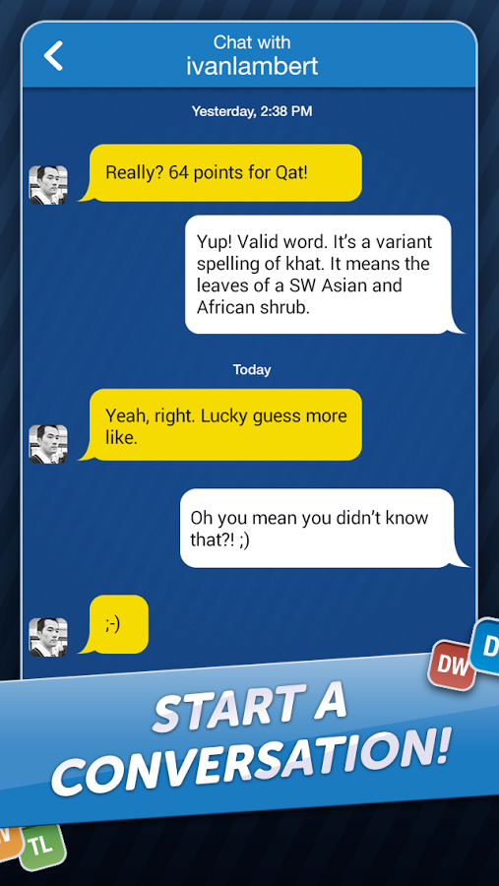
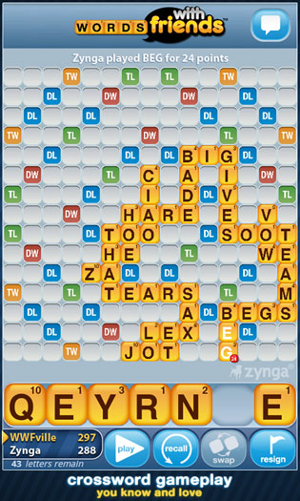
Have you ever lost a thinking game?
Notes:
Cindy
How did you respond? This can reveal a lot about your mindset….
Was losing a reflection/indication of your intelligence or an opportunity to get better at it/learn from your mistakes?
Was playing the game a way to prove your intelligence or a way to improve your thinking skills?
Did you think you lost because of bad luck or because the other person used better strategies?
Would you rather play someone you are likely to beat or someone who is likely to beat you?

Slide 35
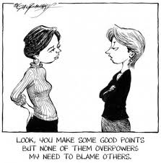
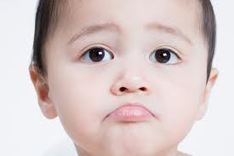
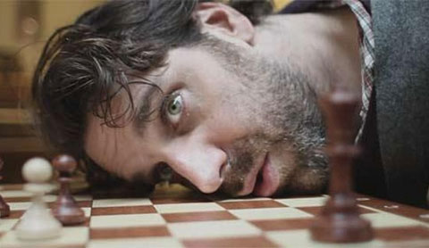
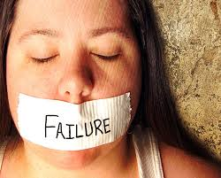
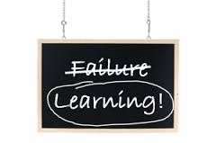
How did you respond?
Notes:
Did you blame the other person for your loss? Did you accuse them of cheating? Did you get pout? Did you want to give up and stop playing? Was losing a reflection/indication of your intelligence or an opportunity to get better at it/learn from your mistakes?
Was playing the game a way to prove your intelligence or a way to improve your thinking skills?
Did you think you lost because of bad luck or because the other person used better strategies?
Would you rather play someone you are likely to beat or someone who is likely to beat you?

Slide 36

Life = Risk

Slide 37
The Power of…
YET

Slide 38
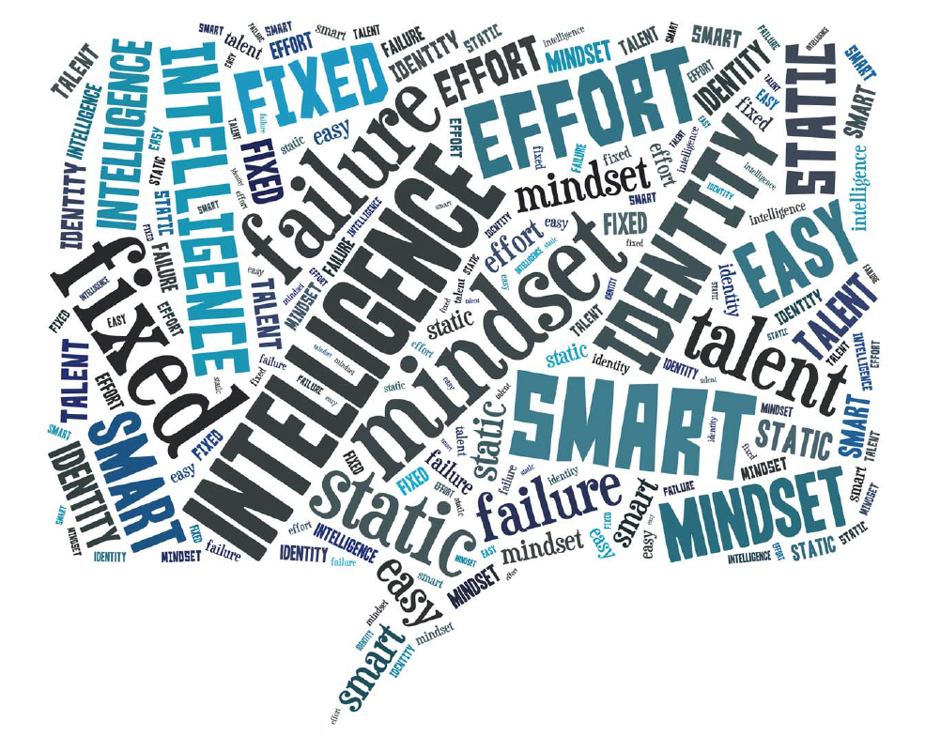
Fixed Mindset Beliefs
Notes:
Basic qualities such as intelligence or talent don’t change much/fixed
Effort is not necessary for natural intelligence or talent
Obstacles are signs that I shouldn’t pursue that goal
Failure reflects on my value, intelligence, and/or talent

Slide 39
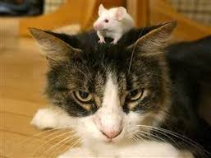




Fixed Mindset Behaviors
Notes:
Avoid challenges
Set easy-to-achieve goals or no goals
Discouraged by failure
Tend to be in denial about flaws/ areas to improve/ blame self or others for failure
Disengage or give up more easily when they encounter setbacks and obstacles
Try to prove themselves over and over

Slide 40
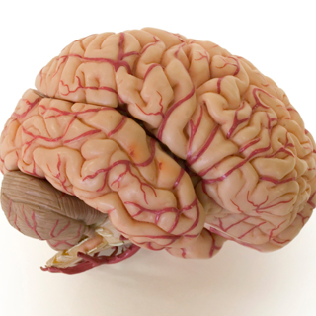

Brain Plasticity
Notes:
Brain plasticity – the brain continues to grow throughout our lives
The brain creates new neurons and connections (even in adulthood)
The more connections, the more learning that is taking place
The more times a connection is ‘fired’, the stronger the learning and memory
Practice, time, connections, and effort literally change the brain
Researchers have found that all students can achieve at the highest levels of math (with the exception of certain disabilities)
Countries that believe this about students perform much better in math than the United States (James Stigler’s research)
Every students’ brain has tremendous capability to change and grow
Every new learning experience can change the brain and one’s ability
Much of our academic culture is structured around outdated ideas based on ‘fixed’ ideas about learning

Slide 41
Growth Mindset Beliefs

Slide 42

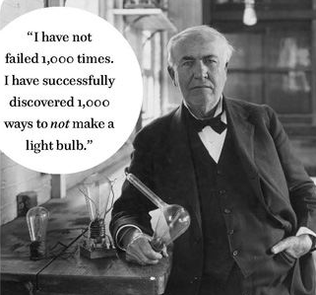
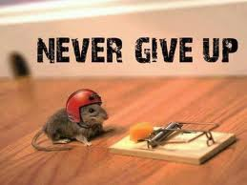

Growth Mindset Behaviors
Notes:
Enjoy and seek challenges
Use failure as a learning opportunity
Have a more accurate view of their abilities/ seek and use feedback
More resilient in the face of setbacks and obstacles

Slide 43



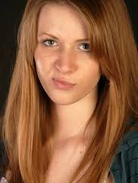
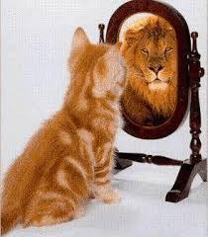

Low Hope Stuck High Hope
Fixed Mindset Growth Mindset
Notes:
Low hope/growth mindset – believe in trying again, open to learning, but may not know how to do it or have a specific direction/goal; negative feedback might make them feel sad but they will try to use the feedback to improve
High hope/fixed mindset – have goals and pathways, but may not have an accurate view of self and/or may give up easily when they hit obstacles or blame others for their failures; argues or gets defensive with feedback
Low Hope/Fixed Mindset – may not know how to get their (pathways), may not have a specific goal (here because I have to be), discouraged easily, frustrated, gives up easily, avoids challenges, doesn’t believe in self; blames self or others for failure; doesn’t respond well to feedback
High Hope/Growth Mindset – believes in self/ability to learn and grow, has specific goal, knows how to get there, enjoys learning and challenges, seeks out feedback

Slide 44
Mindset Scale Score Distribution
Fixed Mindset
Neutral Mindset
Growth Mindset
Number of Students Assessed
Mindset Scale Total Score
N = 4,324; mean = 25.76; median = 25.0; standard deviation = 2.96
Notes:
Jim
Mindset Scale – eight items on five point scale, range is 8 - 40
4 = Fixed Mindset
4 = Growth Mindset

Slide 45
First Semester Success Rate
First Semester Success Rate

Slide 46
FA-to-SP-to-FA Persistence Rate
FA-to-SP-to-FA Persistence Rate

Slide 47
English Basic Skills Improvement Rate
English Improvement Rate

Slide 48
Math Basic Skills Improvement Rate
Math Improvement Rate

Slide 49
Unit Attainment – 30+ Units
30 Unit Attainment Rate

Slide 50
Unit Attainment – 45+ Units
45 Unit Attainment Rate

Slide 51
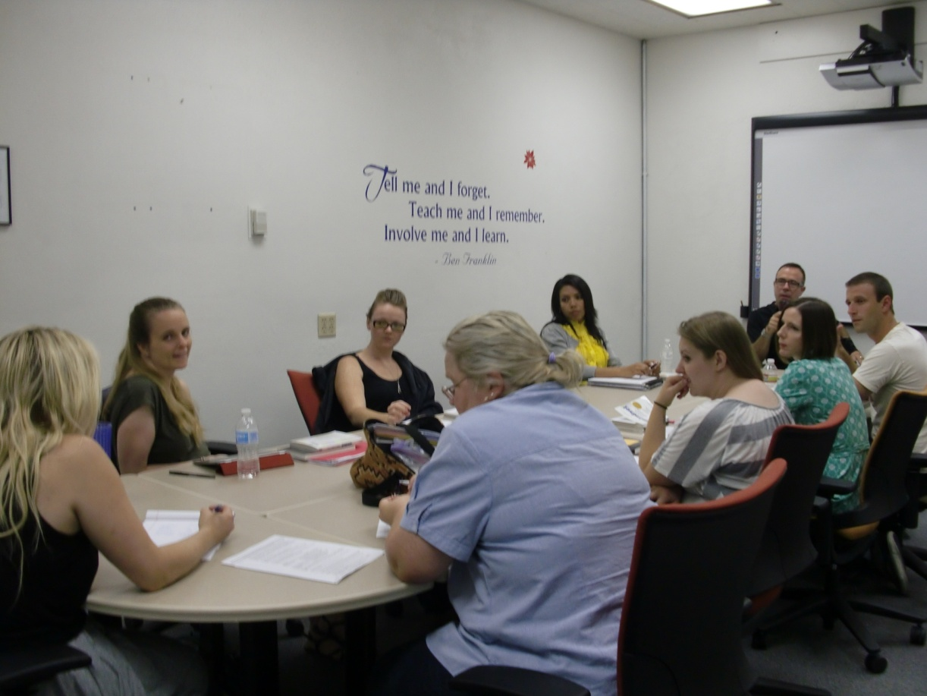
Changing the Institutional Culture
Hiring Process
Train all employee groups
Notes:
Sherrie –
Hiring Process – interview questions, look for growth-minded people
Training all employee groups

Slide 52
Changing the Institutional Culture
Professional Development
Ongoing professional learning
All new full-time employees and faculty
Part-time faculty
Deep and transformative learning
opportunities
Notes:
NFO – full time faculty
Classified Orientation
Online Orientation for Part-time faculty
Faculty Summer Institutes, Seminars, Workshops, Classified workshops, etc.

Slide 53
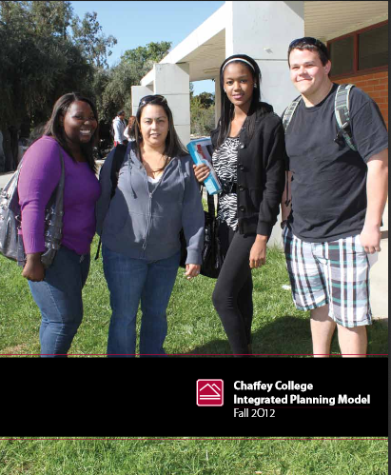
Changing the Institutional Culture
Integrated
Plan
Policies
Procedures
Materials
Notes:
Changing strategic plan, policies and procedures to reflect
hope and mindset values
Strategic plan has hope and mindset as a foundational philosophy
Changed policies (waitlist, add/drop dates, etc.)
Embedded institutional SLOs for hope/mindset
mission statement reflects hope/mindset values
Staff/departments have changed the wording of handouts/info for students
Changed DLAs, Success Center wording on flyers, etc.
Faculty changed syllabi wording/framing

Slide 54
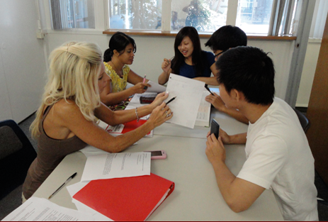
Changing the Institutional Culture
Embedding hope and mindset in programs
Notes:
Embedding hope and mindset in programs
Success Centers (training, DLAs, workshops, groups)
SI (training/approach)
Success Guides (training, materials, approach)
GPS Centers
Counseling/Orientation
Faculty Advising (training, materials, approach)
FSC (workshops, seminars, FSI, etc.)
New Faculty Orientation
Faculty Advising
Concepts developed by faculty are sustained (pre/post/post-post surveys – Jim)

Slide 55
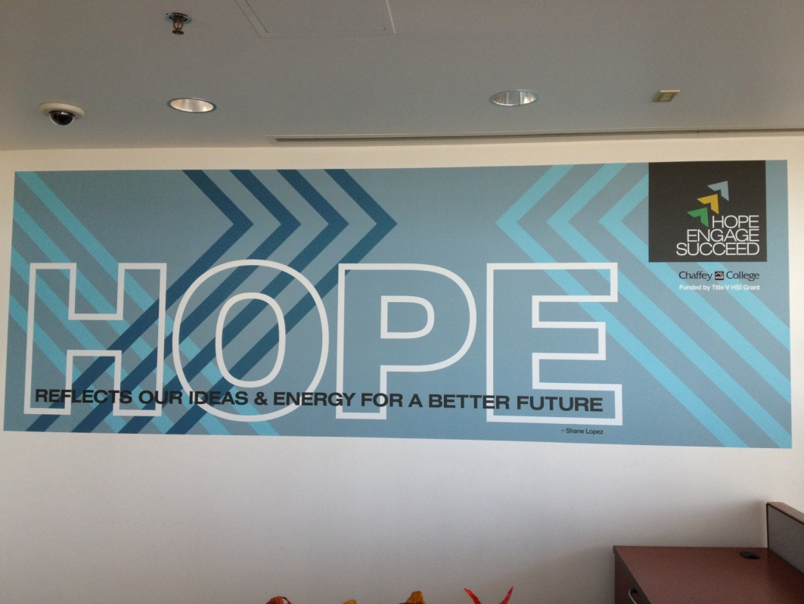
Changing the Institutional Culture
Outreach to Students and Campus-wide Messaging
Notes:
Outreach to students
Campus-wide messaging
Multimedia campaign

Slide 57
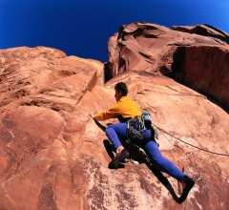
Setting Goals to Succeed
Actions I need to take soon
When/Where
1.
2.
Actions I need to take in the next few weeks
Reward
1.
2.
Actions I need to take in the next few months
1.
2.
SMART goal: ________________________
Obstacle 1 : __________
Obstacle 2 : __________
Obstacle 3 : __________
Resources:
People:
Strategies:
Resources:
People:
Strategies:
Resources:
People:
Strategies:
Handout created by Cindy Walker, 2012
Notes:
Cindy
Create an action plan to implementing an initiative on your campus or in your department/area

Slide 58
Changing Mindsets/Hope – Strategies
My Hope/Mindset
Learn to hear your low hope/fixed mindset scripts and reframe them in high hope/growth mindset ways.
Classmates/Co-workers/Friends
Be available and be an empathetic listener – redirect low hope/fixed mindset statements and attitudes towards high hope/growth mindset thinking.
Becoming a Hopeful Leader
Frame feedback and direction in constructive/positive ways and make it specific
Demonstrate belief in your own capabilities
Reflect on how you’ve overcome past obstacles
Find ways to praise and reward others for using appropriate strategies, processes, effort, and attitudes
Coach others through the thinking process necessary to accomplish the task
Become aware of and develop your strengths
Take on new challenges with a growth mindset
Receive feedback thoughtfully
Learn from mistakes/failures and find ways to make them opportunities for growth
Other:
Demonstrate your belief in other people’s capabilities to complete tasks and achieve goals
Model a high hope/growth mindset to others when starting projects, tasks, etc.
Set challenging goals together
Anticipate potential obstacles and plan pathways to overcome those potential obstacles together
Share how you have overcome obstacles in an area the other person is struggling with
Help others recall past experiences where they have overcome obstacles
Other:
Other:
Notes:
Cindy – skim/highlight only

Slide 59
Be HOPEFUL! Strategies For Success
Harness Your Strengths
Discover your passions, interests, strengths, and learning strategies
Examine how you became good at something and apply those strategies to something you’re struggling to learn
Overcome Obstacles
Predict possible difficulties or obstacles you might face and seek out tools, resources, and people who can help you overcome these potential obstacles.
Think of alternate pathways to achieve your goal.
Plan and Prioritize
Use planning tools, lists, etc. to help you keep track of and be prepared for due dates, tests, assignments, etc.
Always keep your goals in mind. Consider ways that your classes and assignments can help you reach your goals.
Embrace the Journey
Approach learning with a growth mindset
Remember that learning is a process – enjoy the journey
Be prepared to work hard
Learn as much as you can from mistakes
Focus on your Progress
Track your own progress in your classes
Look closely at graded work that your instructors hands back to you – make an effort to understand the feedback/grade
Celebrate your successful completion of tasks, assignments, etc. and see them as one step closer to achieving your goals
Utilize Resources
Learn about and try new study/organizational strategies
Find a mentor, tutor, or teacher to guide you in your journey
Be creative and resourceful. Seek out solutions to any problems you might be facing.
Use Chaffey’s resources to help you achieve your goals (Success Centers, SI, library, financial aid, Career Center, Counseling, health services, etc.)
Live Out Your Dreams
Find meaningful ways to celebrate your progress and achievement of your goals
Keep going! Once you’ve reached a goal, set a new one.

Slide 60

Reflections on Hope and Mindset
Notes:
Sherrie

